Slide 1
MI Theory Project Synopsis and Literature Survey
B Section, 2022
Project Title: EMAIL-SPAM FILTERING SYSTEM
TEAM:
Sreekar Govind SRN: PES2UG20CS125
Adarsh Kumar SRN: PES2UG20CS016
Aryaman Yadav SRN: PES1UG20CS079

Slide 2
Abstract
What is the problem you are solving ?
In our daily life usage, we use the emailing system to send and receive various messages for personal, work, basic communication between sources. But when we receive a message that is not benefical to our needs or is not meant to be associated to our needs in any way, we term it as a spam message. Spam can hinder our daily mails and make it hard to differentiate between spam and our importnt day-to-day mails.
Describe the need and significance of the problem.
A spam filter is a program used to detect unsolicited, unwanted and virus-infected emails and prevent those messages from getting to a user's inbox.

Slide 3
Scope
A spam filter is a program used to detect unsolicited, unwanted and virus-infected emails and prevent those messages from getting to a user's inbox and it provides a personalized classification.

Slide 4
Dataset
Dataset source
-kaggle: https://www.kaggle.com/datasets/nitishabharathi/email-spam-dataset?select=completeSpamAssassin.csv
Dataset size
-22417(10.83Mb)
Any preprocessing done, mention ?
- Yes, The algorithm then reads these parameters to determine the level of priority. The preparation of data thus consists of the retrieval of emails and their scanning
Any data analytics used ? why ?
Yes, The accuracy of the final algorithm is directly proportional to the amount of training it receives. We used Outlier Analysis, This is done primarily to find ‘outliers’
Any statistical analysis used ? Why ?
- Statistical analysis done b/w algorithms such as logistic regression, non-spam email classification, Random Forest algorithms, supervised learning, Support Vector Machines and we observed that Random Forest algorithms gives us the best result.

Slide 5
Machine Learning related Details
Machine learning algorithms planning to use:
Naïve Bayes
Decision trees
Neural networks
Random forest.
ML Library used
-Numpy
-sklearn
-matplotlib

Slide 6
Design Approach / Methodology / Planning of work
Building this kind of a ML project involves the following important steps –
a. Text Processing
b. Text Sequencing
c. Model Selection
d. Implementation
Use libraries like Sklearn, NumPy, Counter, Scrubadub, Beautifier, Seaborn, and machine learning frameworks like TensorFlow and Keras. For training such machine learning models, a Spam base dataset. Spam base dataset is an open-source UCI machine learning repository comprising around 5569 emails, of which nearly 745 are spam emails

Slide 7
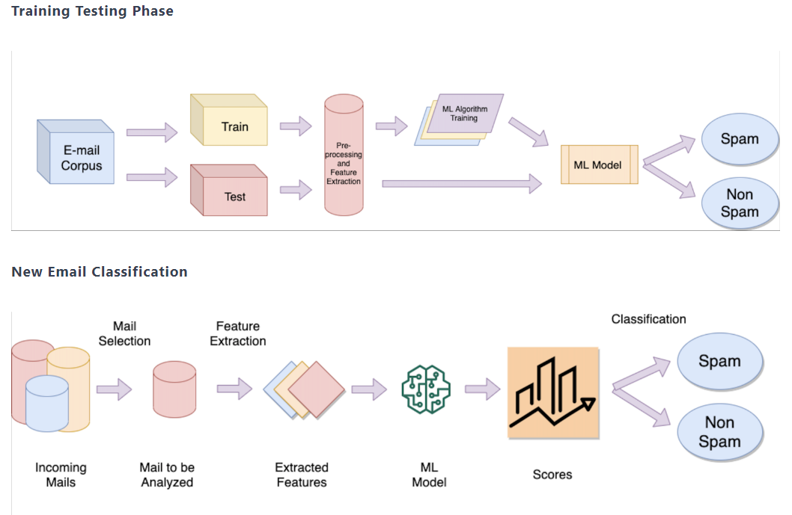
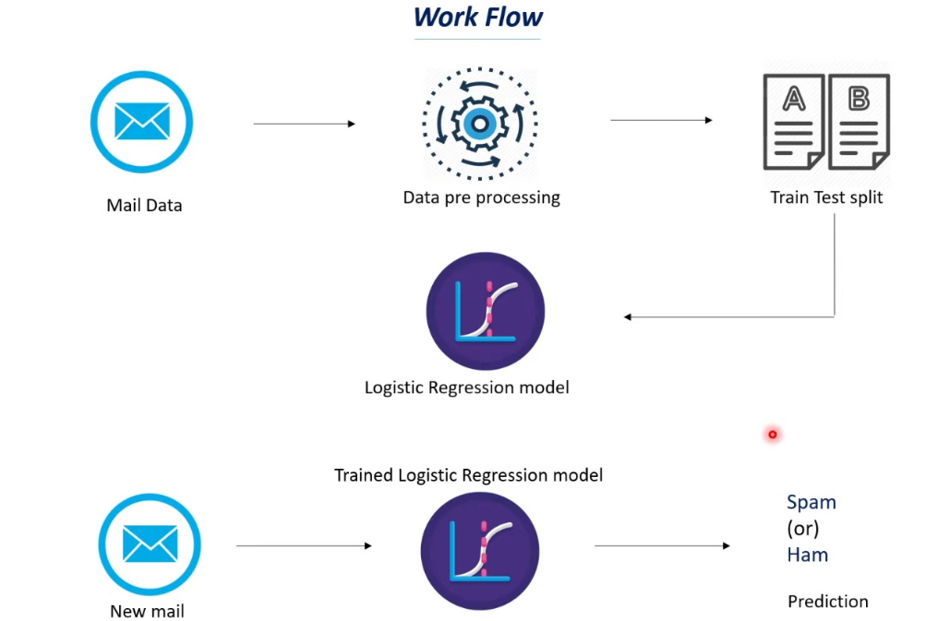
Design Details

Slide 8
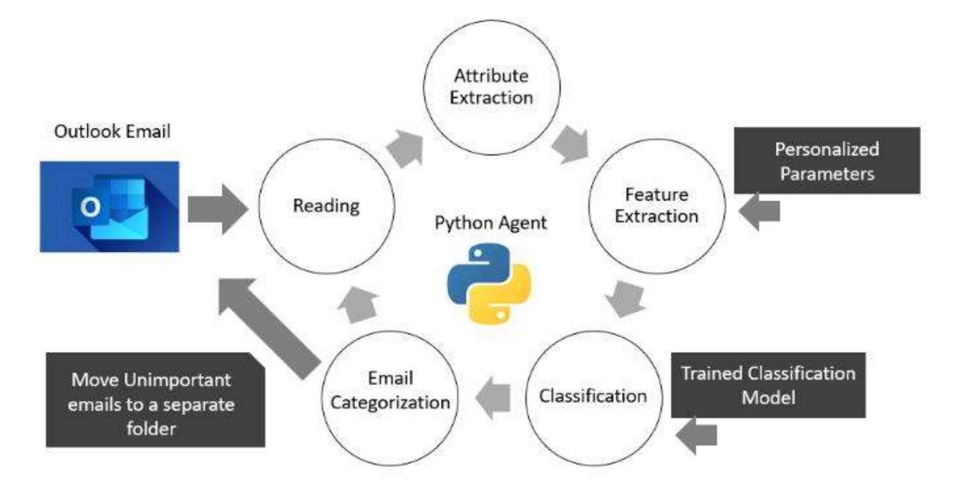
Design Details

Slide 9
Literature Survey - 5 Papers

Slide 10
Paper 1: Content Based Spam E-mail Filtering
Year of Publication: 2016 International Conference on Collaboration Technologies and Systems (CTS)
Authors: Pingchuan Liu
Teng-Sheng Moh
Dataset: The original dataset is CSDMC2010 SPAM corpus. This dataset is composed of a selection of mail messages as training data and testing data.

Slide 11
Paper 1: Abstract & Methodology
Currently, E-mail is one of the most important methods of communication. However, the increasing of spam emails causes traffic congestion, decreasing productivity, phishing, which has become a serious problem for our society. And the number of spam e-mail is increasing every year.
Therefore, spam e-mail filtering is an important, meaningful and challenging topic. The aim of this research is to find an effective solution to filter possible spam e-mails. And as we know, in recent days, there are many techniques that spammers use to avoid spam-detection such as obfuscation techniques.
In this case, the following proposed approach uses email content only to build keyword corpus, together with some text processing to handle obfuscation technique.

Slide 12
Paper 1: Merits & Demerits
Merits:
Spam filters save time that you could have wasted on removing spam from your Inbox.
The previously reported spam messages will no longer hit your Inbox.
Demerits:
Thousands of spam emails may reach Inboxes before a spammer’s email address, IP or domain is blacklisted.
Spam filtering is machine-based so there is a room for mistakes called “false positives.”
Bayesian filters may be fooled by spammers, e.g. in a case of using large blocks of legitimate text.
A legitimate email sender may use potentially “suspicious” words without knowing it and trigger a spam filter.

Slide 13
Paper 1: Conclusion & Motivation
In this paper, we proposed a content-based spam email filtering approach. The system uses keyword-based corpus that were built from training datasets to classify new incoming email message. In order to improve the accuracy of our algorithm, we came up with some different processes to handle obfuscated, insignificant, or infrequent words. We performed some experiments to evaluate our proposed work.
However, there are still some fields we can improve in the future. For example, currently we are only focus on the email content, however, there are some useful information we can use in the email header part such as sender email address and IP address, email subject, number of recipients or even time.

Slide 14
Paper 2: Existing Spam Filtering Methods Considering different technique
Year of Publication: 2021 International Conference on Technological Advancements and Innovations (ICTAI)
Authors: Lipsa Das
Laxmi Ahuja
Adesh Pandey
Dataset: The original dataset is CSDMC2010 SPAM corpus. This dataset is composed of a selection of mail messages as training data and testing data.

Slide 15
Paper 2: Abstract & Methodology
Today, social media and email are become a very common and the most effective medium for communication and data transferring which has been greatly affected by undesired spam by sharing unwanted and malicious contents to Internet users which, brings financial losses to organizations as well as become a headache for individual users and leads to decrease in productivity considerably.
The spam occupies storage and the communication bandwidth as well as a network threat, when it contains viruses and malicious codes. On an average a user on internet may get 10-20 spam emails per day. For solving spam problems, different counter measures need to deploy to detect and remove these unwanted messages. This paper summarizes the survey of different existing email spam filtering techniques such as how machine and non-machine learning approaches are used to detect incoming unsolicited emails.

Slide 16
Paper 2: Merits & Demerits
Merits:
These different filters show IP addresses that are known to the user and can be found if spam or not.
The message has to be sent twice by a trusted user.
Suspected keywords are known and also with the availability of best heuristic function.
Suspected keywords are known with their spam probability
Demerits:
It is difficult to detect or find the suspected IP and also
contains errors.
It may declare the unknown genuine mail as spam.
Genuine emails may also contain suspected keywords.

Slide 17
Paper 2: Conclusion & Motivation
For the new generation internet world the malicious spam is become a very serious problem. It is threatening for network integrity and also degrade the user productivity. In this paper summarize the problem developed due to malicious spam emails and gave a summary of different techniques for spam filtering.
Considering the literature search, it can be said that, the most effective content based filtering technique is Bayesian filtering method. With some pre-processing steps of spam keywords training, the effectiveness of Bayesian spam filtering method can enhanced.

Slide 18
Paper 3: Personalized Classification of Non-Spam Emails Using Machine Learning Techniques
Year of Publication: 2022 International Research Conference on Smart Computing and Systems Engineering (SCSE)
Authors: Lipsa DasHarsha Dinendra
Laxmi Ahuja Chathura Rajapakse
Adesh Pandey P.P.G. Dinesh Asanka
Dataset: The original dataset is CSDMC2010 SPAM corpus. This dataset is composed of a selection of mail messages as training data and testing data.

Slide 19
Paper 3: Abstract & Methodology
With the advent of computer networks and communications, emails have become one of the most widely accepted communication means, which is faster, more reliable, cheaper, and accessible from anywhere. Due to the increased use of email communications, day-to-day computer users; particularly corporate users, find it cumbersome to filter the most important and urgent emails out of the large number of emails they receive on a given business day.
Thus, it is desired to have an email filtering system for non-spam emails to filter unimportant emails, based on the user’s past behaviour. Despite the availability of research on identifying spam e-mails in the area of further classifying the non-spam e-mails, is lacking. The purpose of this research is to provide a machine learning-based solution to classify non-spam e-mails considering the importance of such e-mails. As part of the research, several machine learning models have been developed and trained using non-spam e-mails, based on the personal mailbox of the first author of this research.

Slide 20
Paper 3: Merits & Demerits
Merits:
Previous machine learning algorithm uses only categories like sport, travel, appointment, social media and personal but this will capture the subject matter of this project-personalized classification of non-spam e-mails.
Unlike other models this have abundant algorithm like logistic regression, non-spam email classification, Random Forest algorithms, supervised learning, Support Vector Machines which give us best optimised result end-to-end implement is considerable high.
Less amount of Generic data being used is being used in the other research’s attempt to classify emails into predefined categories such as Shopping Domain, social media, Appointments, Parenting, Personal, Travel, Notably, it doesn’t have any consideration on whether the email is important or not personalized parameters were used during the feature engineering process so that the classification will be personalized and improve the accuracy further as well as accommodate the changes that happened to the environment over time.
The label accuracy with the default labels is 95%
Der-merits:
The required data to train the machine learning model were extracted from the personal mailbox, The attributes available for extraction include subject, body, sender, receiver, date and time, email type, size, attachments and important which hinder the privacy of the users certain attributes had been dropped because there was no variance in their values.
No one knows how machine will react to sensitive data which will we shared on the mail.
SVM and KNN are not really providing convincing results for important emails.• As the “Word Cloud” is not actually a static data set, it needs to be re-constructed and fed into the agent, as the nature of the email subject and contents keep on getting changed over time.
Because of lot of heavy algorithms is used it made the model complex.

Slide 21
Paper 3: Conclusion & Motivation
In this work, an approach for personalized email classification was introduced, powered by supervised machine learning models. The primary objective of the classification is to correctly classify emails as "important" and "unimportant", which is a highly personalized classification. There were many features which are engineered, to get the personal flavor to the classification. When it comes to the class, if an email is classified as "unimportant" then the accuracy should be high while recall should be high for the "important" class.

Slide 22
Paper 4: A Proposed Data Science Approach for Email Spam Classification using Machine Learning Techniques
Year of Publication: 2017 Internet of Things Business Models, Users, and Networks
Authors: Aakash Atul Alurkar
Sourabh Bharat Ranade
Shreeya Vijay Joshi, and others…
Dataset: Enron email dataset collected and prepared by the CALO Project

Slide 23
Paper 4: Abstract & Methodology
With the facility of email being accessible to any individual with an internet connection, the proliferation of spam emails is one of the biggest problems which plagues our globally integrated communication systems. The various solutions to filter and hide spam previously included the manual detection of specific keywords and the backlisting of certain domains created to send spam. However, these methods have certain shortcomings in classifying whether emails are spam or ham. This proposed system attempts to use machine learning techniques to detect a pattern of repetitive keywords which are classified as spam.

Slide 24
Paper 4: Merits & Demerits
Merits:
This proposed system attempts to use machine learning techniques to detect a pattern of repetitive keywords which are classified as spam, spam previously included the manual detection of specific keywords and the blacklisting of certain domains created to send spam.
The system also proposes the classification of emails based on other various parameters contained in their structure such as Cc/Bcc, domain and header.
Since this model don’t check for body content this model is givers better privacy to the users.
A three-tier architecture which is also a client-server architecture is incorporated in the proposed model. Which help task to achieve modularity and thus, reduce overall computation load on the system.
Demerits:
This system mainly focusses on categorizing emails in two categories, namely spam and non-spam. At an organizational level, an effective and flexible classifier improves the soundness of its employee’s email system.
This model doesn’t have self-learning system which is customizable to each user and based on their dataset will only ensure greater accuracy as the dataset grows in size. Thus, the system approaches an optimal solution as time passes
This model blocks the email of the sender who are likely to spam from a predefined list by the system administrator, in some condition they might try to send legitimate mail those can also be blocked.
Since the classification algorithm needs a dataset upon which to perform its functionalities, it is of utmost importance that emails are retrieved with a hundred percent accuracy from their respective servers, irrespective of their domain.

Slide 25
Paper 4: Conclusion & Motivation
Spam filtering is a kind of email prioritization but it only focuses on filtering unwanted emails or two level prioritization systems. Sahami et al reported good results in Spam filtering using Naive Bayes classifiers.
However, spam filtering alleviates the overload of the recipients to a certain degree but with these changes, it is possible to develop an email system which gives more efficient and accurate results. Along with this,system which provides an output that is user-specific has been aimed for. This ensures a superior user experience for every individual who uses the system.

Slide 26
Paper 5: TITLE : A Comprehensive Review on Email Spam Classification using Machine Learning Algorithms
Year of Publication: 2021
Authors: Mansoor RAZA and Nathali Dilshani Jayasinghe School of Computing and Mathematic
Charles Sturt University, Study Centre Melbourne VIC 3000, Australia
Muhana Magboul Ali Muslam Department of Information Technology College of Computer and Information Sciences AI Imam Mohammad Ibn Saud Islamic University (IMSIU)
Dataset: The original dataset is CSDMC2010 SPAM corpus. This dataset is composed of a selection of mail messages as training data and testing data.

Slide 27
Paper 5: Abstract & Methodology
Email is the most used source of official communication method for business purposes. The usage of the email continuously increases despite of other methods of communications. Automated management of emails is important in the today’s context as the volume of emails grows day by day. Out of the total emails, more than 55 percent is identified as spam. This shows that these spams consume email user time and resources generating no useful output. The spammers use developed and creative methods in order to fulfil their criminal activities using spam emails, Therefore, it is vital to understand different spam email classification techniques and their mechanism. This paper mainly focuses on the spam classification approached using machine learning algorithms. Furthermore, this study provides a comprehensive analysis and review of research done on different machine learning techniques and email features used in different Machine Learning approaches.

Slide 28
Paper 5: Merits & Demerits
Merits:
Ensemble methods on the other hand proven to be useful as they using multiple classifiers for class prediction. Nowadays , lots of emails are sent and received and it is difficult as our project is only able to test emails using a limited amount of corpus. Our project, thus spam detection is proficient of filtering mails giving to the content of the email and not according to the domain names or any other criteria.
Good Efficiency
Greater accuracy
Demerits:
Automatic email filtering may be the most effective method of detecting spam but nowadays spammers can easily bypass all these spam filtering applications easily.
Naive Bayes is one of the utmost well-known algorithms applied in these procedures. However, rejecting sends essentially dependent on content examination can be a difficult issue in the event of bogus positives. Regularly clients and organizations would not need any legitimate messages to be lost. The boycott approach has been probably the soonest technique pursued for the separating of spams. The technique is to acknowledge all the sends other than those from the area/electronic mail ids.

Slide 29
Paper 5: Conclusion & Motivation
High adoption rate for supervised machine learning approach can be seen throughout the review. This approach is used mainly because it generates higher accuracy results with less variation giving high consistency for this approach. Apart from that, we have found out that certain algorithms such as Na¨ıve Based and SVM have high demand compared to other Machine Learning Algorithms. The multi algorithm used systems are more common in use to cater better outcome rather than using single algorithm. Researchers have more focused on email features such as BoW and Body text creating future research opportunities to develop systems to detect spam on other email features.

Slide 30
References
From Research Paper-1
L. Firte, C. Lemnaru, R. Potolea, “Spam Detection Filter using KNN Algorithm and Resampling,” Intelligent Computer Communication and Processing (ICCP), 2010 IEEE International Conference on, pp. 27–33, 26-28 Aug 2010.
From Research Paper-2
Drucker et al.(1999), for classifying the email text content used ( support vector machines method, then compared it with other algorithm like Boosting decision trees , Ripper & Racchio [21]
From Research Paper-3
S. P. Gautam, “Email classification using a self-learning technique based on user preferences”, Master. dissertation, Dept. Comp. Sc., North
Dakota State Univ., Fargo, ND, 2015.
From Research Paper-4
Yoo, S.(2010), Machine learning methods for personalized email prioritization. PhD. Carnegie Mellon University
From Research Paper-5
F. Qian, Y. C. H. Abhinav Pathak, Z. M. Mao, and Y. Xie, “A case for
unsupervised-learning-based spam filtering,” Univ. Minnesota J., 2010.

